Slide 1
Ouńjẹ ní ilẹ̀ yorùbá
DIFFERENT KINDS OF FOOD

Slide 2
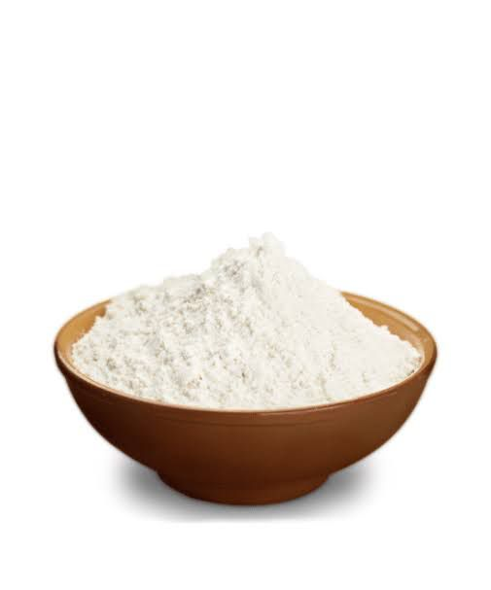
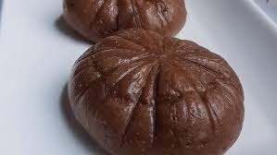
Èlùbọ́ : Yam Flour Powder
…ni a fi n ṣe
…is used to prepare
Àmàlà

Slide 3
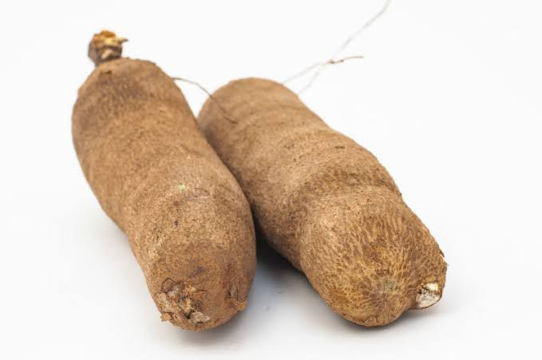
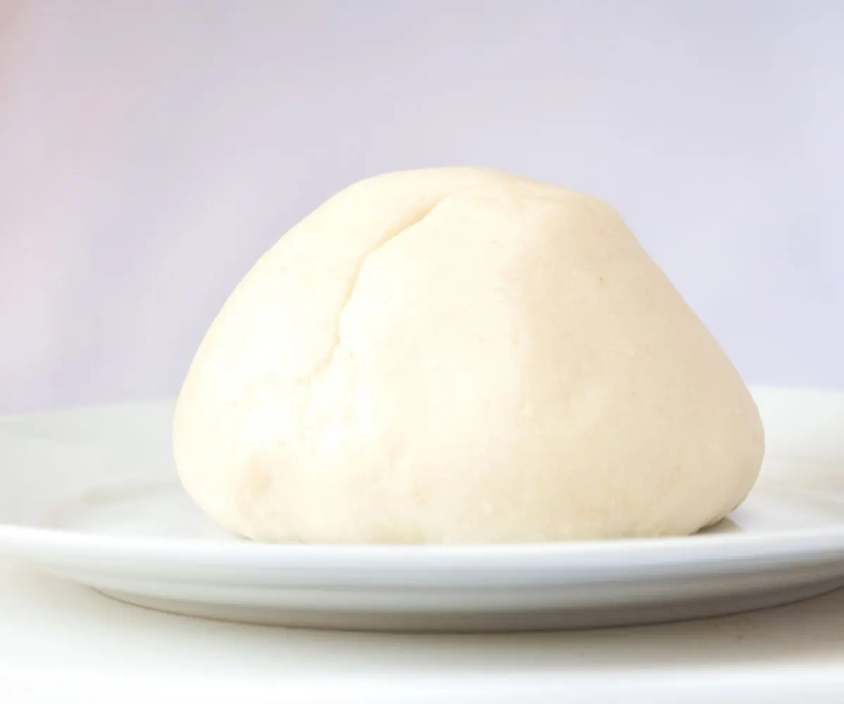
Iṣu - Yam
…ni a fi n ṣe
…is used to prepare
Iyán- Pounded Yam

Slide 4
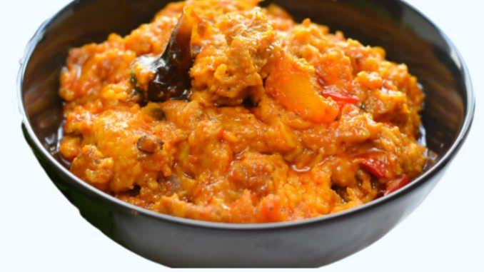
Iṣu - Yam
…ni a fi n ṣe
…is used to prepare
Ìkọkọré- Water Yam Pottage

Slide 5
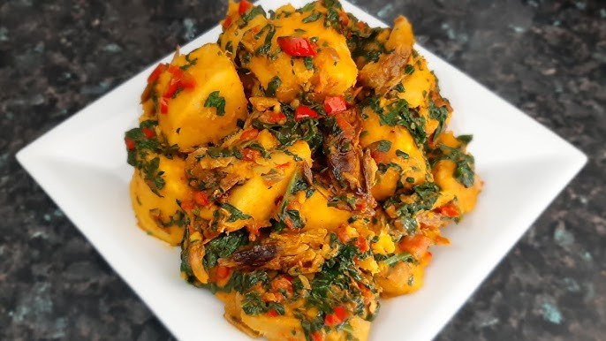
Iṣu - Yam
…ni a fi n ṣe
…is used to prepare
Àsáró - Yam Pottage

Slide 6
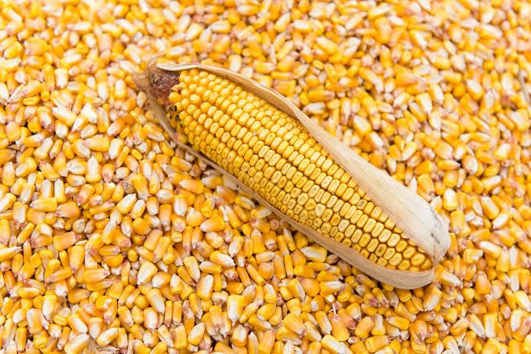
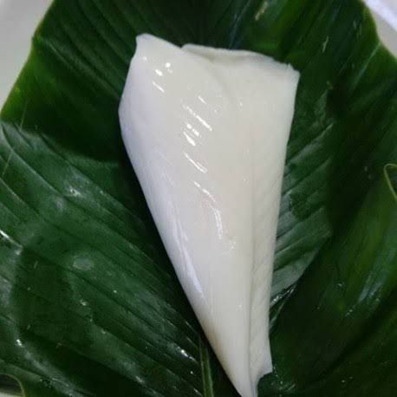
Àgbàdo - Maize
…ni a fi n ṣe
…is used to prepare
Ẹ̀kọ - Corn flour jello

Slide 7
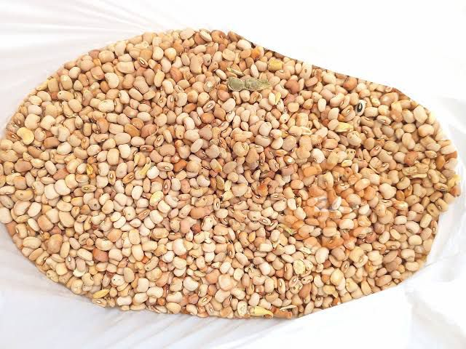
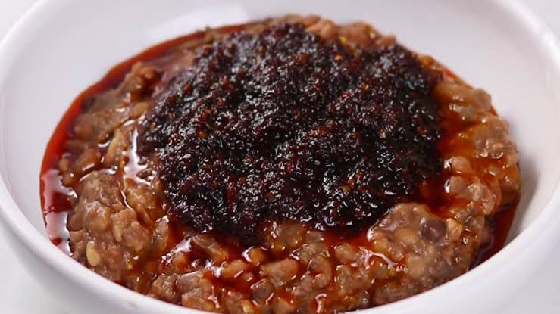
Ẹ̀wà - Beans
…ni a fi n ṣe
…is used to prepare
Ẹ̀wà Àgọ̀nyìn – Mashed Beans

Slide 8
Ẹ̀wà - Beans
…ni a fi n ṣe
…is used to prepare
Èkuru – White Steamed Bean Cake

Slide 9
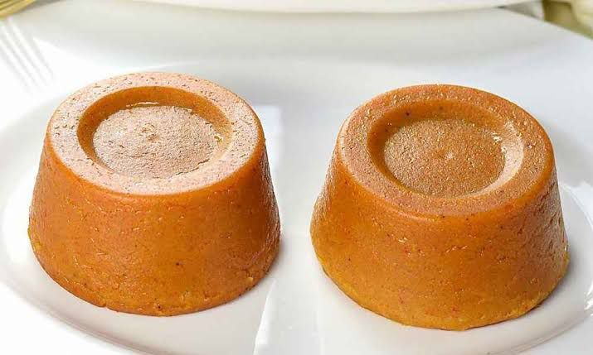
Ẹ̀wà - Beans
…ni a fi n ṣe
…is used to prepare
Mọ́imọ́i - Bean pudding

Slide 10
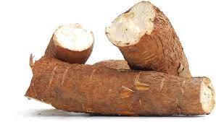
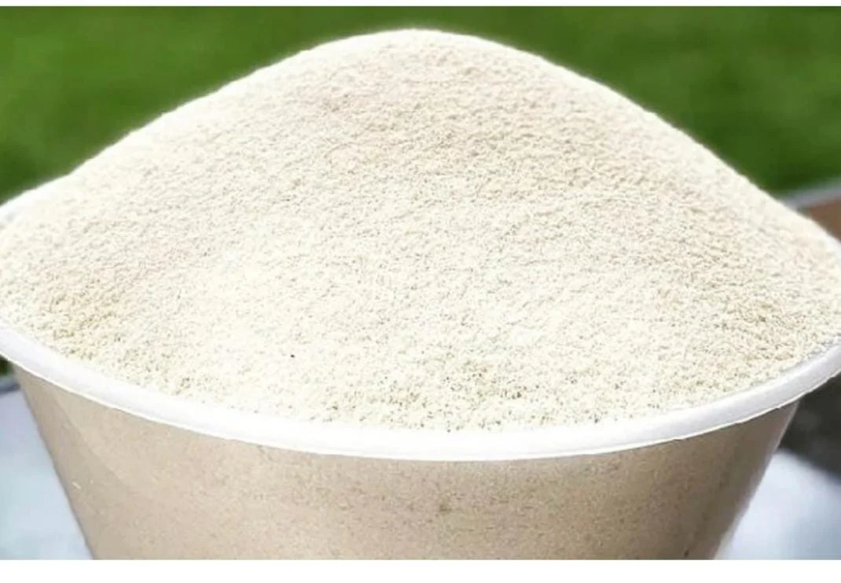
Ẹ̀gẹ́ - Cassava
…ni a fi n ṣe
…is used to prepare
Gààrí – Cassava flake

Slide 11
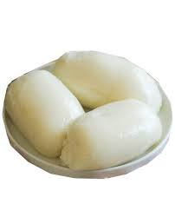
Ẹ̀gẹ́ - Cassava
…ni a fi n ṣe
…is used to prepare
Fùfú – Steamed Pounded Cassava

Slide 12
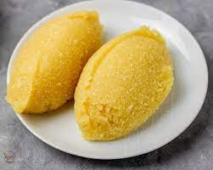
Ẹ̀gẹ́ - Cassava
…ni a fi n ṣe
…is used to prepare
Èbà – Steamed Cassava flake

Slide 13
Àyẹ̀wò Ẹ̀kọ́
Write 5 names Yoruba Food

Slide 14
Ó dààbọ̀

