Slide 1
Àwọn ohun èlọ̀ ilé ìdáná
Things in the Kitchen

Slide 2
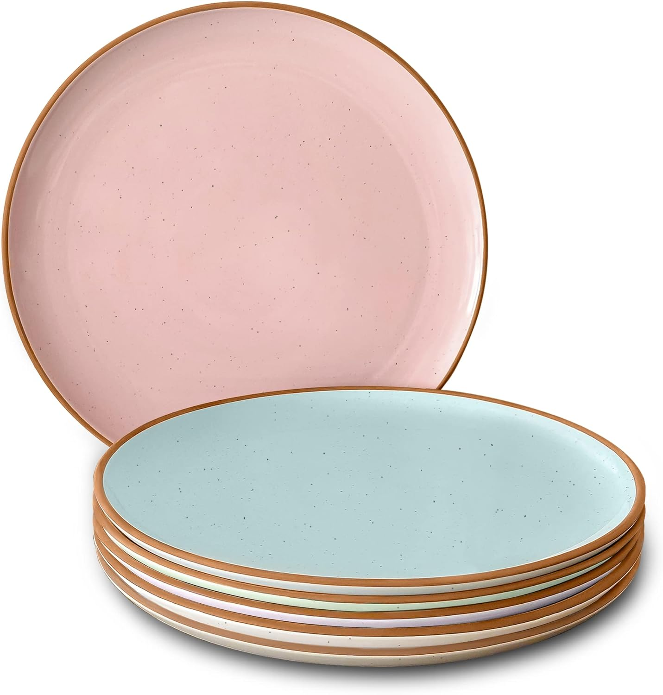
Ceramic/Glass plate
Àwo

Slide 3
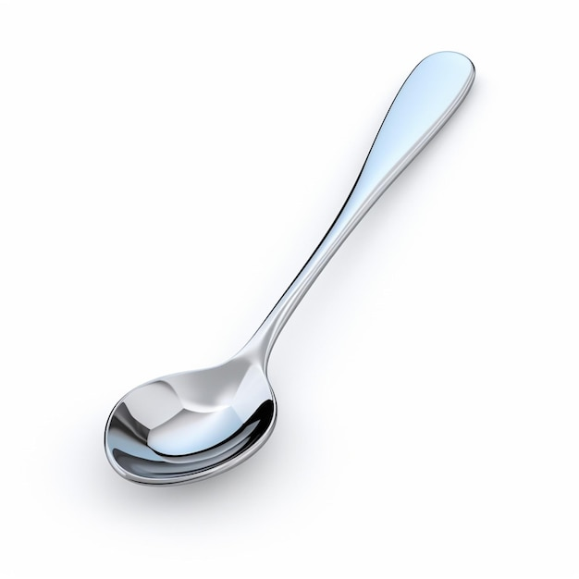
Spoon
Ṣíbí

Slide 4
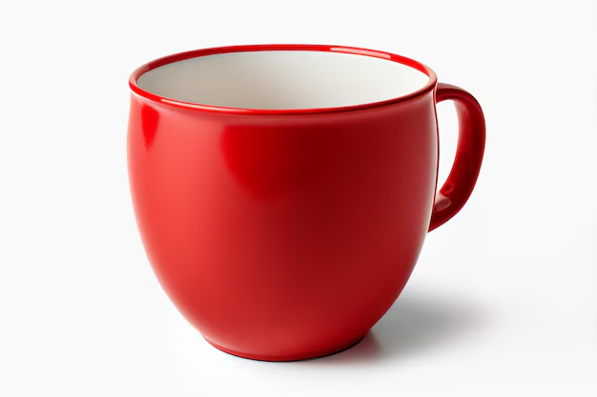
Ife ìmumi
Cup

Slide 5
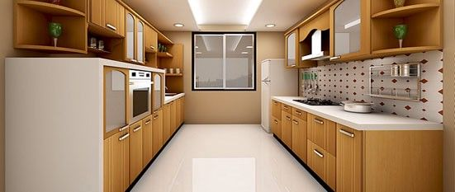
Àpótí Ìdáná
Kitchen Shelf

Slide 6
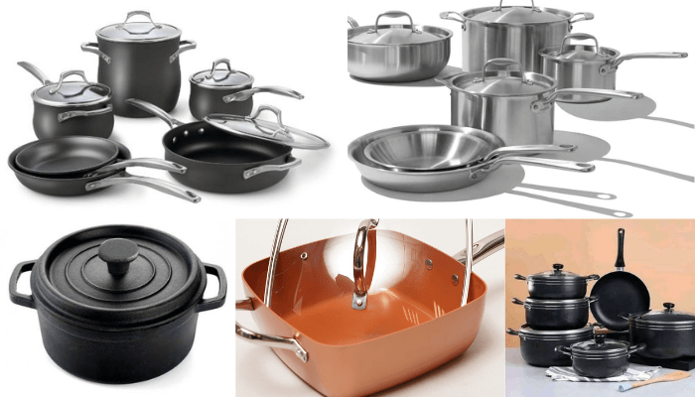
Pots
Ìkòkò

Slide 7
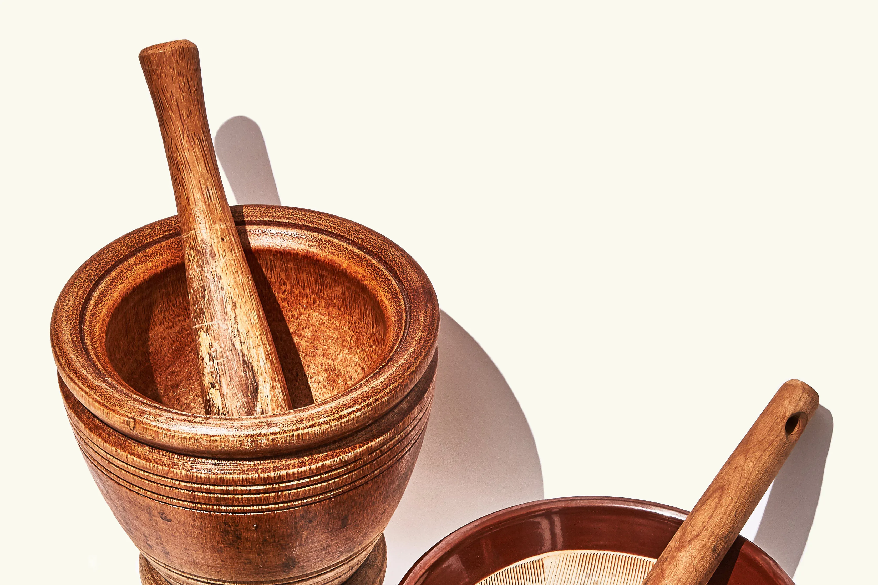
Mortar and Pestle
Odó àti ọmọ odó

Slide 8
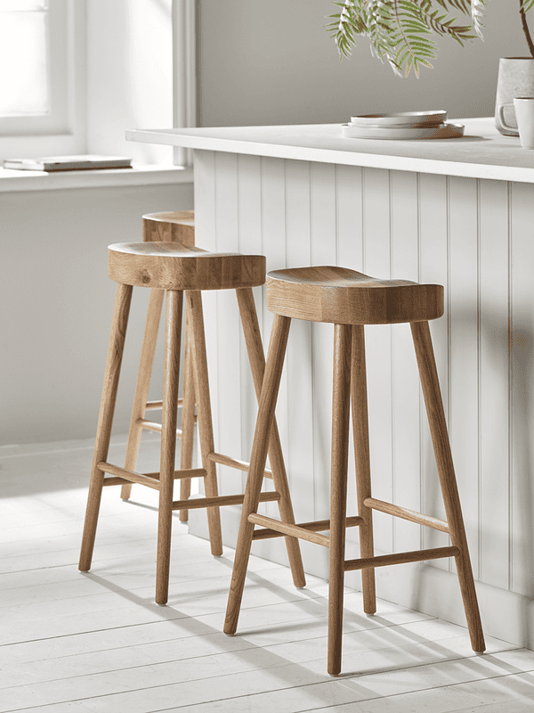
ìjókòó ilé ìdáná
Kitchen Stool

Slide 9
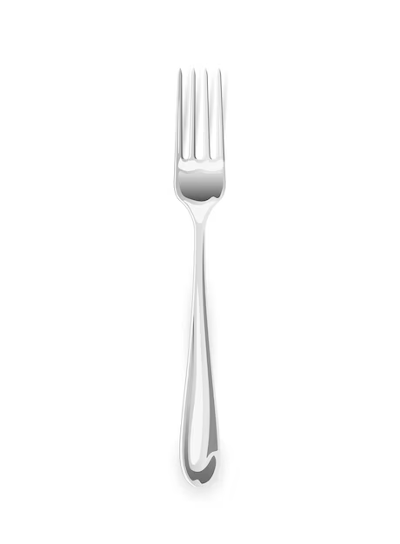
Àmúga
Fork

Slide 10
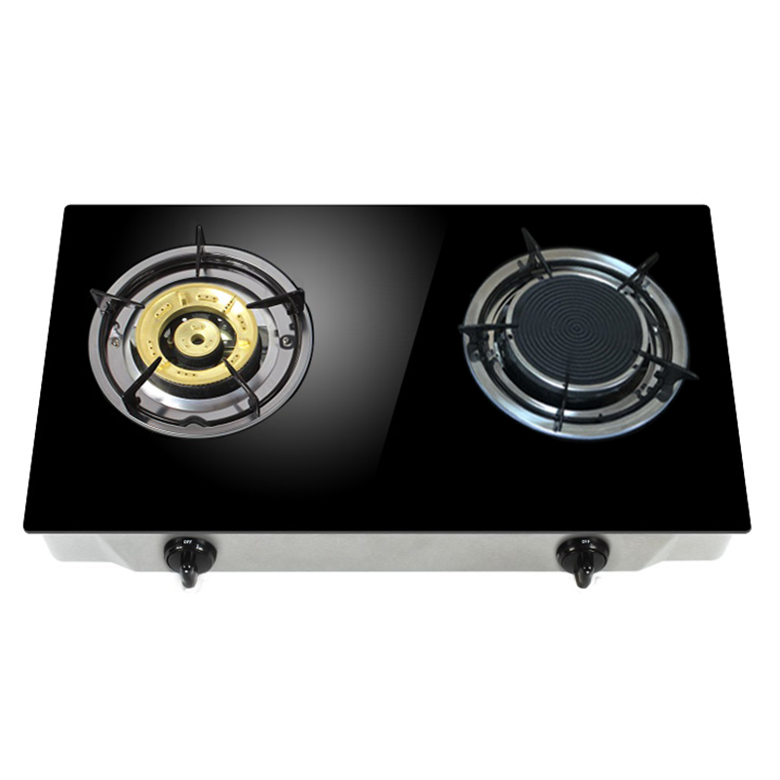
Ìdáná ìgbalódé
Gas Cooker

Slide 11
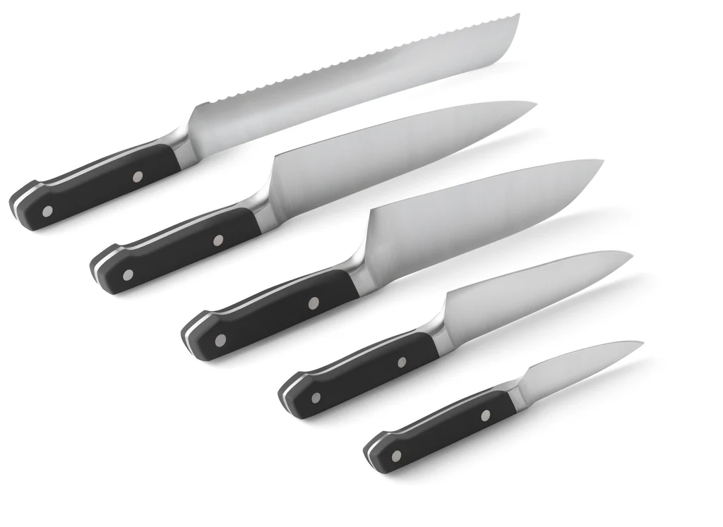
Knives
Ọ̀bẹ

Slide 12
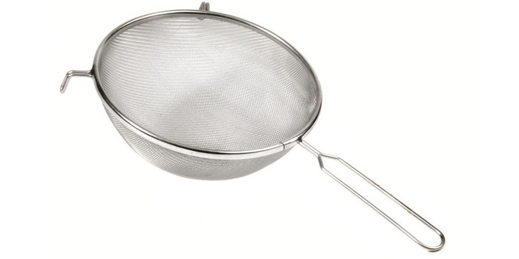
Seive
Asẹ́

Slide 13
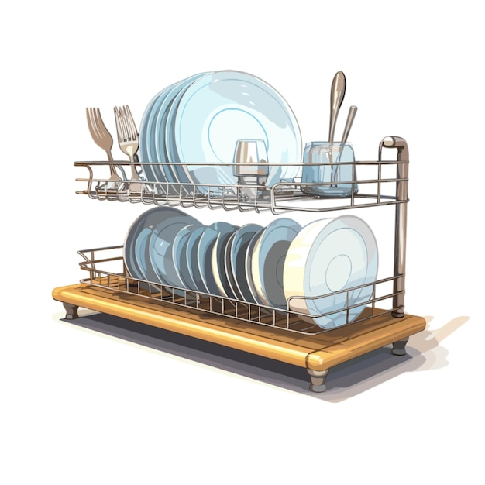
Àpótí àwo
Plate Rack

Slide 14
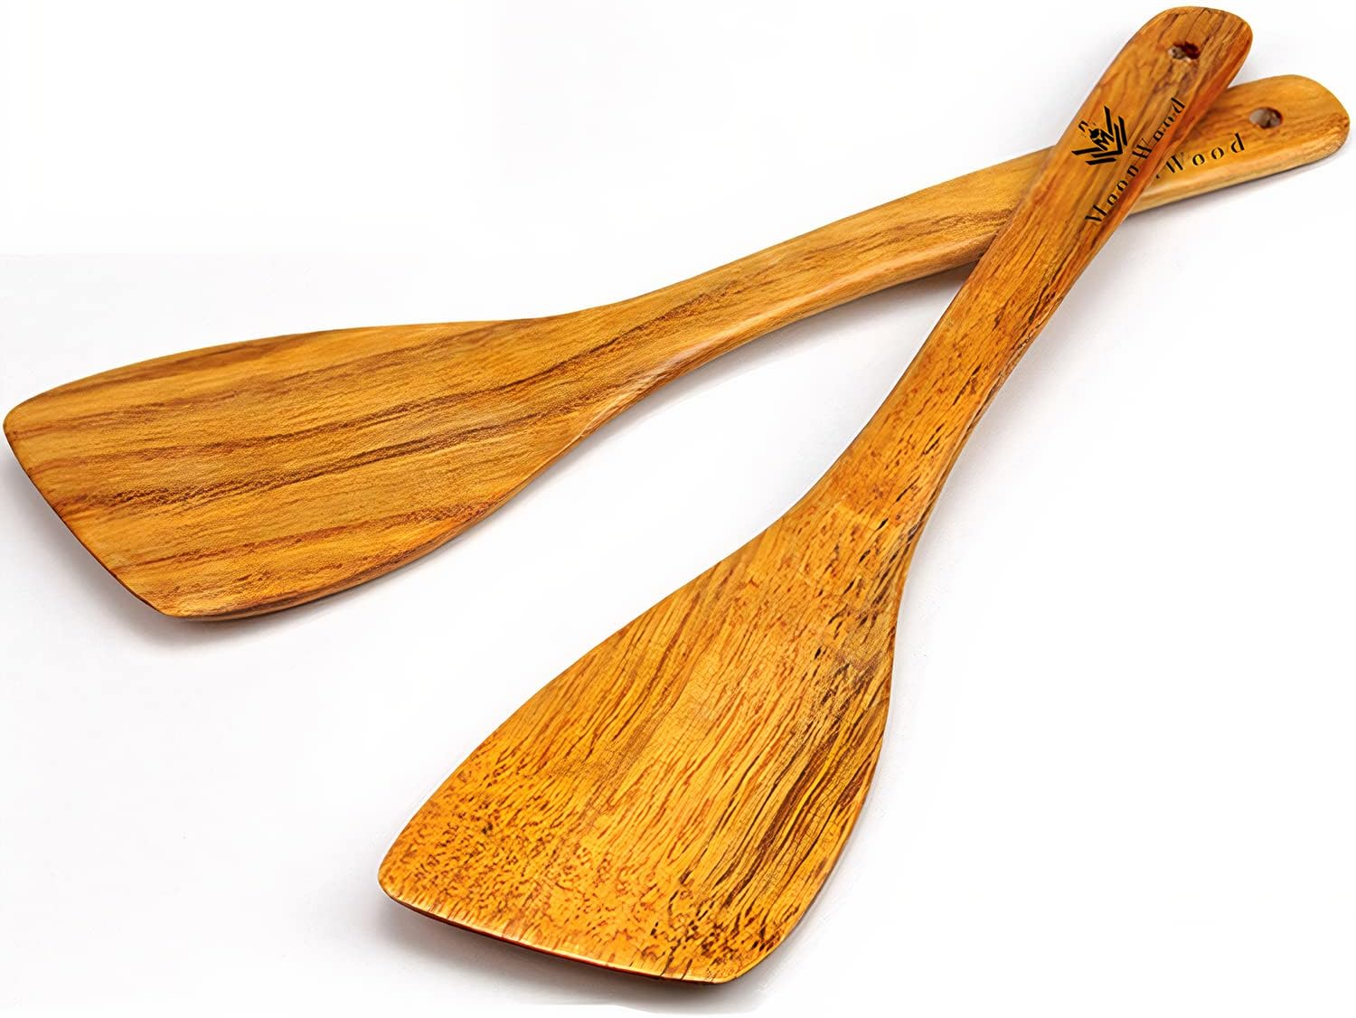
Spatula
Orógùn

Slide 15
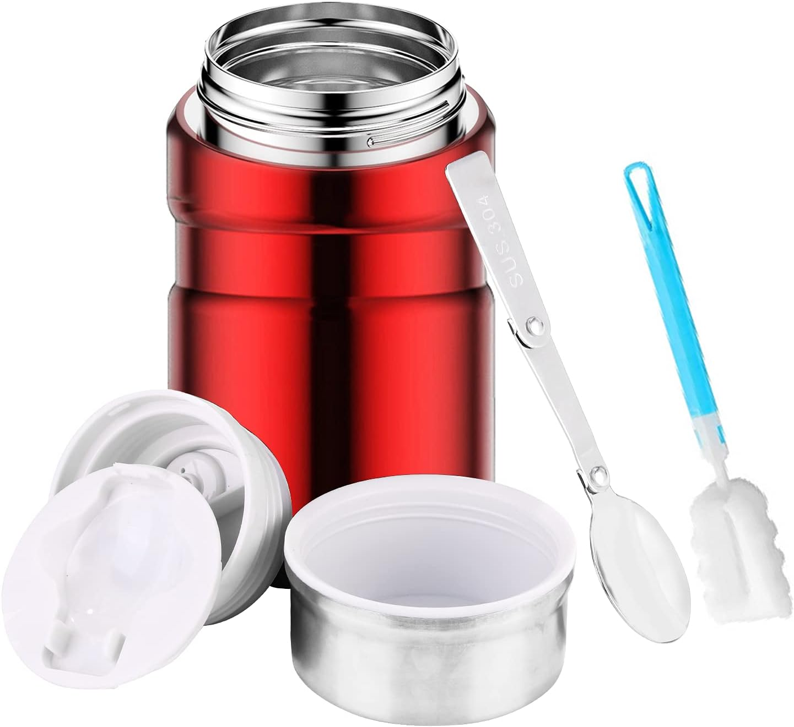
Food Flask
Ṣágo

Slide 16
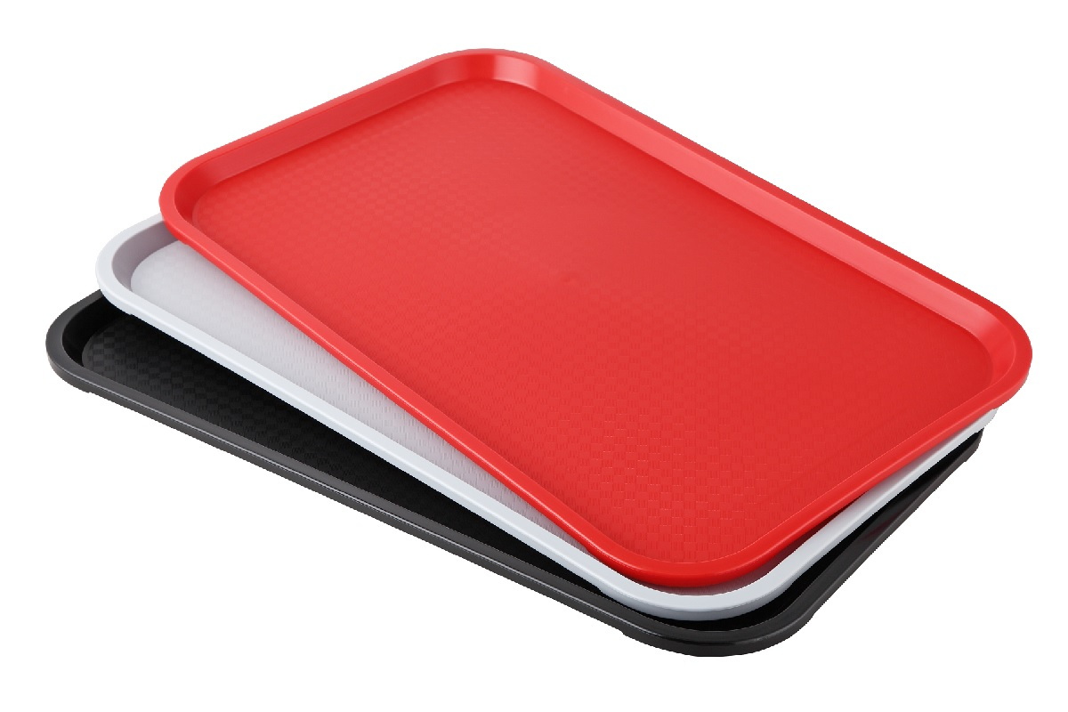
Tray
Àtẹ

Slide 17
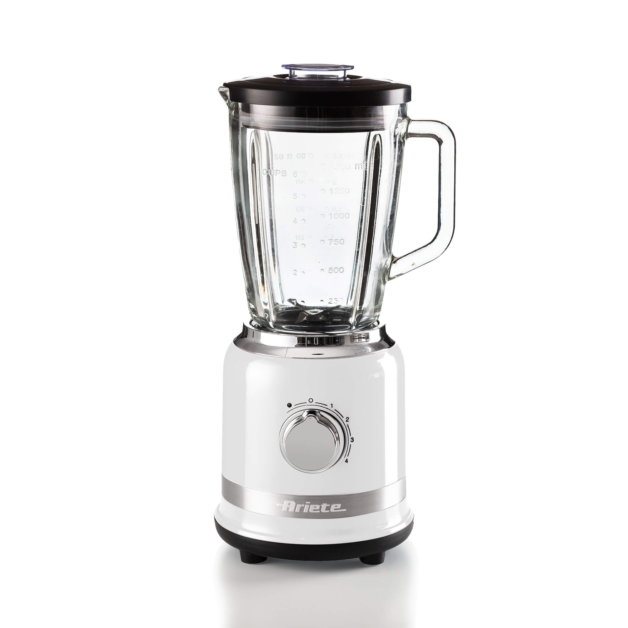
Blender
Ẹ̀rọ ìlọta

Slide 18
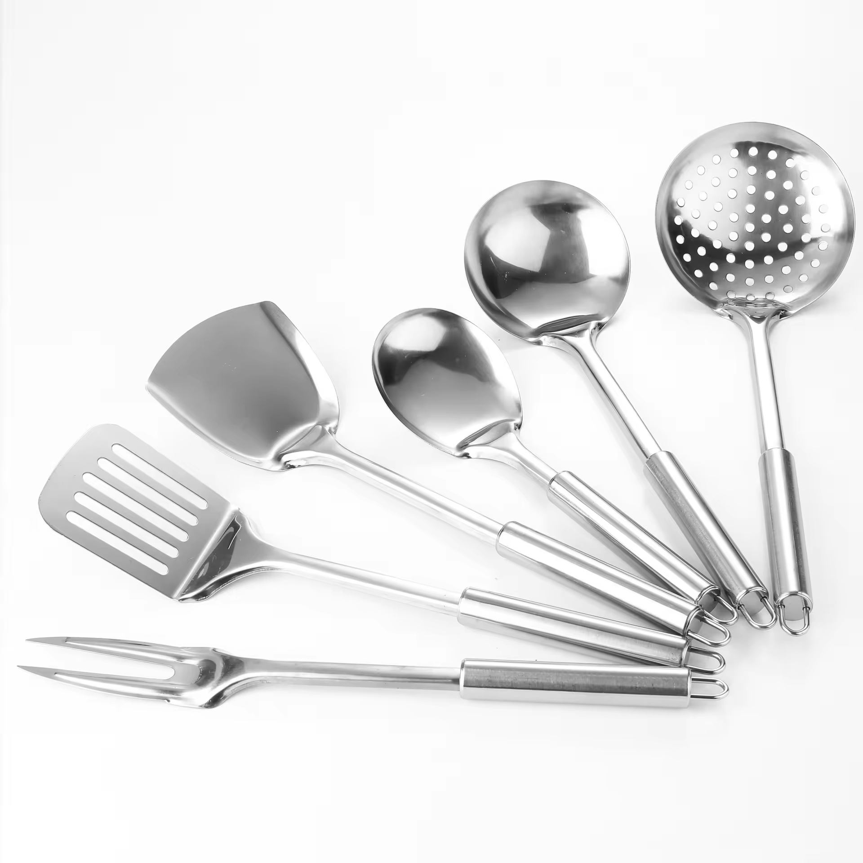
Cooking Spoon
Ṣíbí ìsebẹ̀

Slide 19
Àyẹ̀wò Ẹ̀kọ́
Write the following in Yoruba
Blender
Gas Cooker
Spatula
Pots

Slide 20
Ó dààbọ̀

